Slide 1
Pipeline Project An analysis of the program funnel
Graham Harris
NYU Entrepreneurial Institute
Final Presentation
Notes:
Hi

Slide 2
Overview
Test the hypothesis of the “funnel” of events
Sub-objectives: data cleaning and diversity
Spent first month cleaning 3 years worth of coaching, SS, FF, HTSAS, Bootcamps, Sprints, Launchpads
Clustered this data into network visuals
Present a package of findings/insights for improved marketing, programs dev., etc.
Cleaned data located in Google folder
Didn’t have time to do gender data – can be separate task?
Notes:
Are people actually travelling through the funnel in the way that we think they are?
Final draft is a data resource for everyone to use going forward
Hyperlink

Slide 3
Funnel
HTSAS, SS, FF (coaching)
Bootcamp
Sprints (Summer and J-Term)
Launchpad
Top:
Bottom:
Sub-funnel
Notes:
Funnel and sub-funnel structure

Slide 4
Assumptions/Notes
Data cleaning:
I stopped counting founders after the 4th person for programs.
Affinity data (all people and organizations) is from July 14th, 2021
Names changes – team registered one name for a program, then use another down the funnel
Normal computing errors (extra spaces, misspelled names, etc.)
Sprints: attendee data for sprints isn’t separated into January/Summer

Slide 5
Methodology
People vs. Teams:
People: funnel as a whole
Teams: efficacy of the sub-funnel
For both people and teams:
2018-2019, 2019-2020, 2020-2021
All the above
All the above, simplified (without dates)
10 total graphs

Slide 6
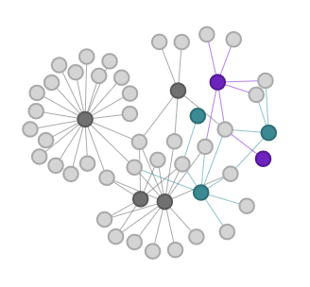
How to read the graphs
Person/Team
Sub-funnel Participant
Top of Funnel Event
Sub-funnel Applicant
Notes:
Network graph - funnel and sub-funnel structure
Explain what a node and edge are
NOTE: Summer program attendees will NOT have the percentage because the data is skewed. Everyone who got into a summer program (SLP and Summer Sprint) had to have applied. The way I calculated the percentages was by seeing who attended only one program, whereas those would technically count as two.

Slide 7
Graphs
Notes:
So without further ado….
start w teams

Slide 8
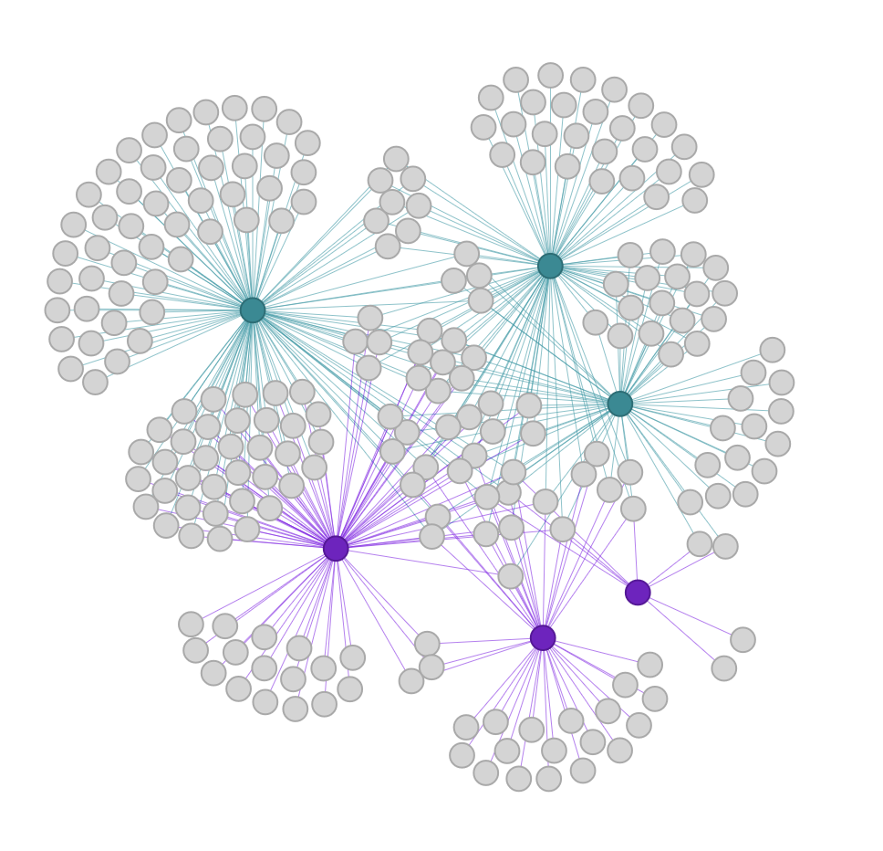
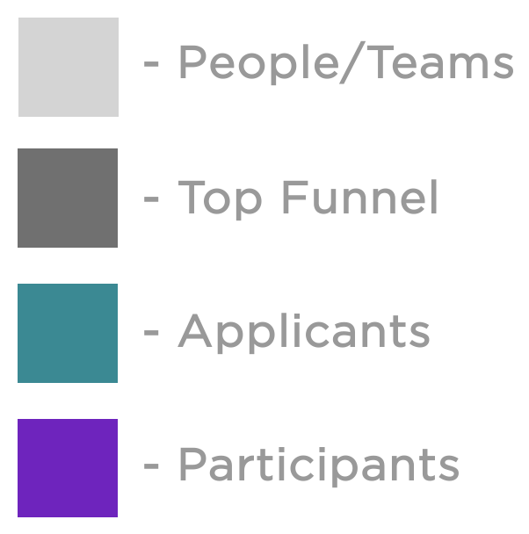
Teams 2018-2019
Sprint Apps
Bootcamp Apps
(29.7%)
(41.6%)
SLP Apps
(21.9%)
SLP Participants
(17.7%)
Bootcamp Participants
(45.0%)
Sprint Participants
Notes:
*** before getting into individual graphs, show all three and talk about how similar they all are
This is IRRESPECTIVE OF NAME CHANGES. If someone changed their team name after a bootcamp, for example, that would not register. I got some of them but not all

Slide 9
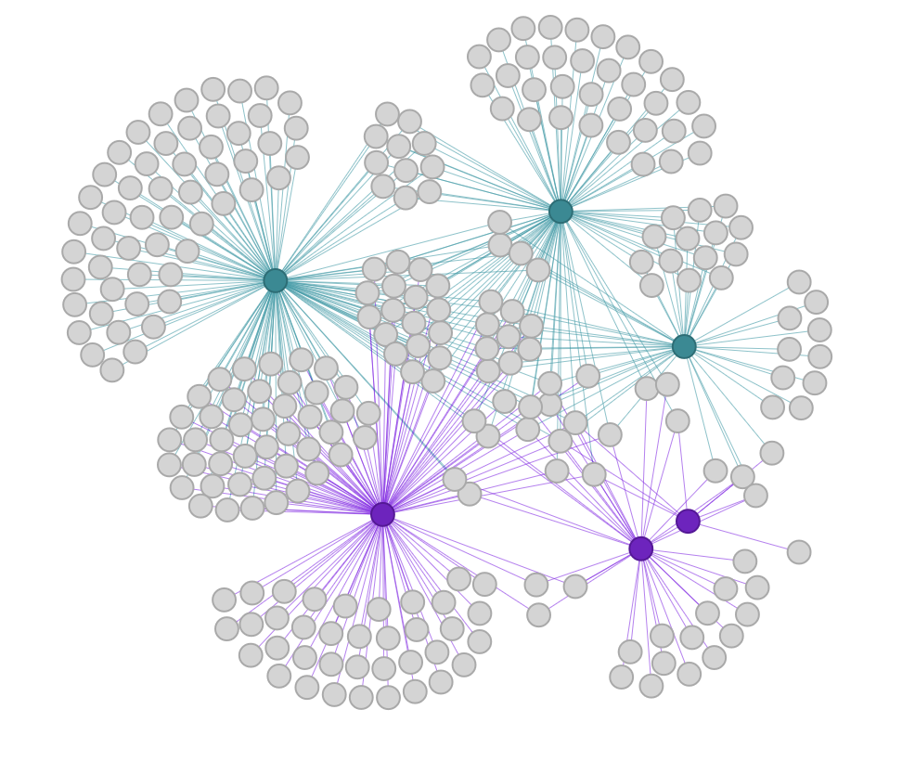
Teams 2019-2020
Sprint Apps
Bootcamp Apps
(31.4%)
(36.2%)
SLP Apps
(20.4%)
SLP Participants
(29.6%)
(38.8%)
Bootcamp Participants
Sprint Participants

Slide 10
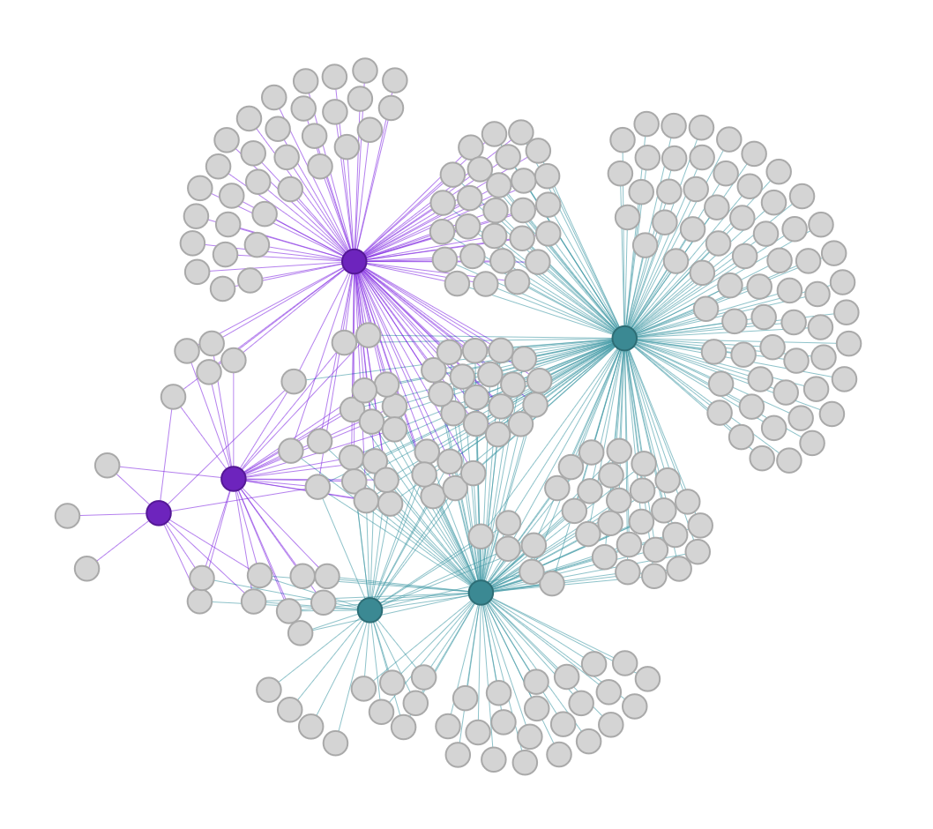
Teams 2020-2021
Sprint Apps
Bootcamp Apps
(21.2%)
SLP Apps
(40.1%)
(11.4%)
SLP Participants
(0%)
(20.0%)
Bootcamp Participants
(30.5%)
Sprint Participants

Slide 11
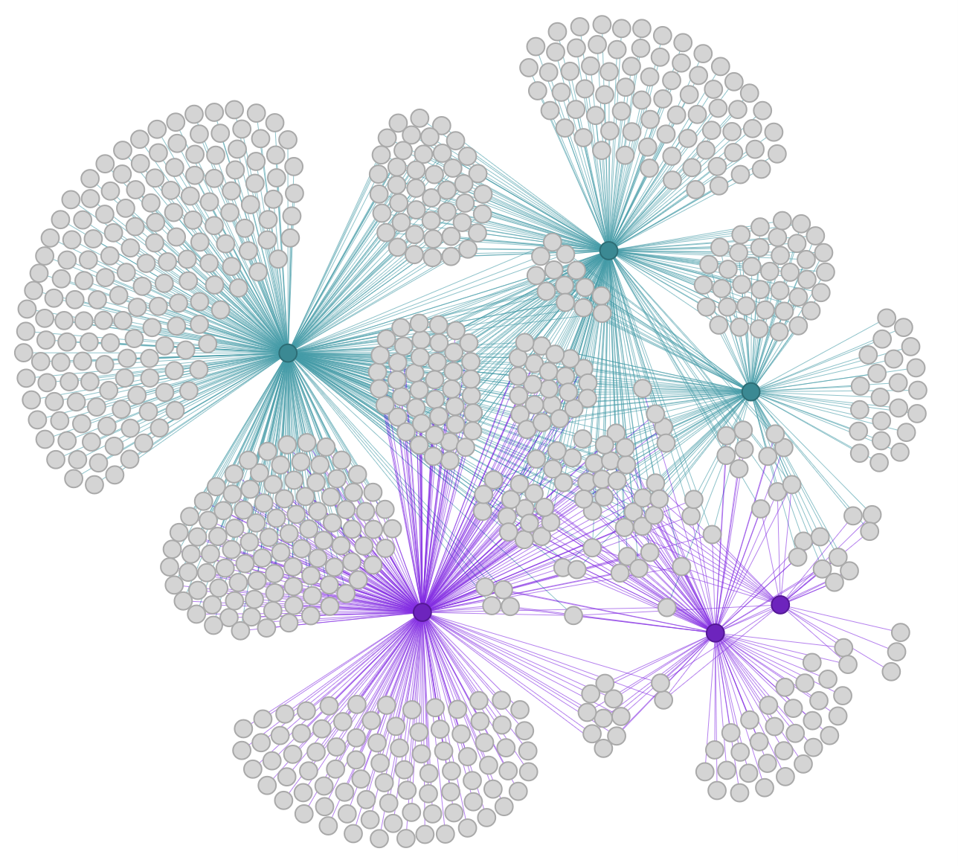
Teams Fall 2018 – Spring 2021
Sprint Apps
(24.8%)
SLP Apps
(38.3%)
(15.4%)
Bootcamp Apps
SLP Participants
Bootcamp Participants
(10.7%)
(26.6%)
(26.9%)
Sprint Participants

Slide 12
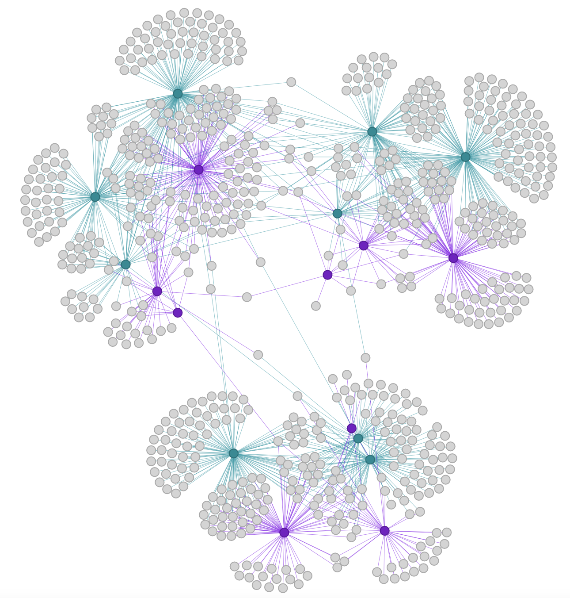
2019-2020
Teams Across All 3 Years
4X as many teams total, 3X relative to size of each year
(2.0%)
6 teams
(6.6%)
22 teams
2018-2019
2020-2021
Notes:
Shows relationship between the years
I went through and calculated the rate of change by using the number of teams who continued to participate next year over the total number of teams in that year. Example: if 10 teams participated from 2018-2019, and only 1 of them continued to participate into 2019-2020, that would be a follow-through rate of 5%
Do better teams go through time, do better teams stay w us longer?
Givee Rebecca the names of crossover teams

Slide 13
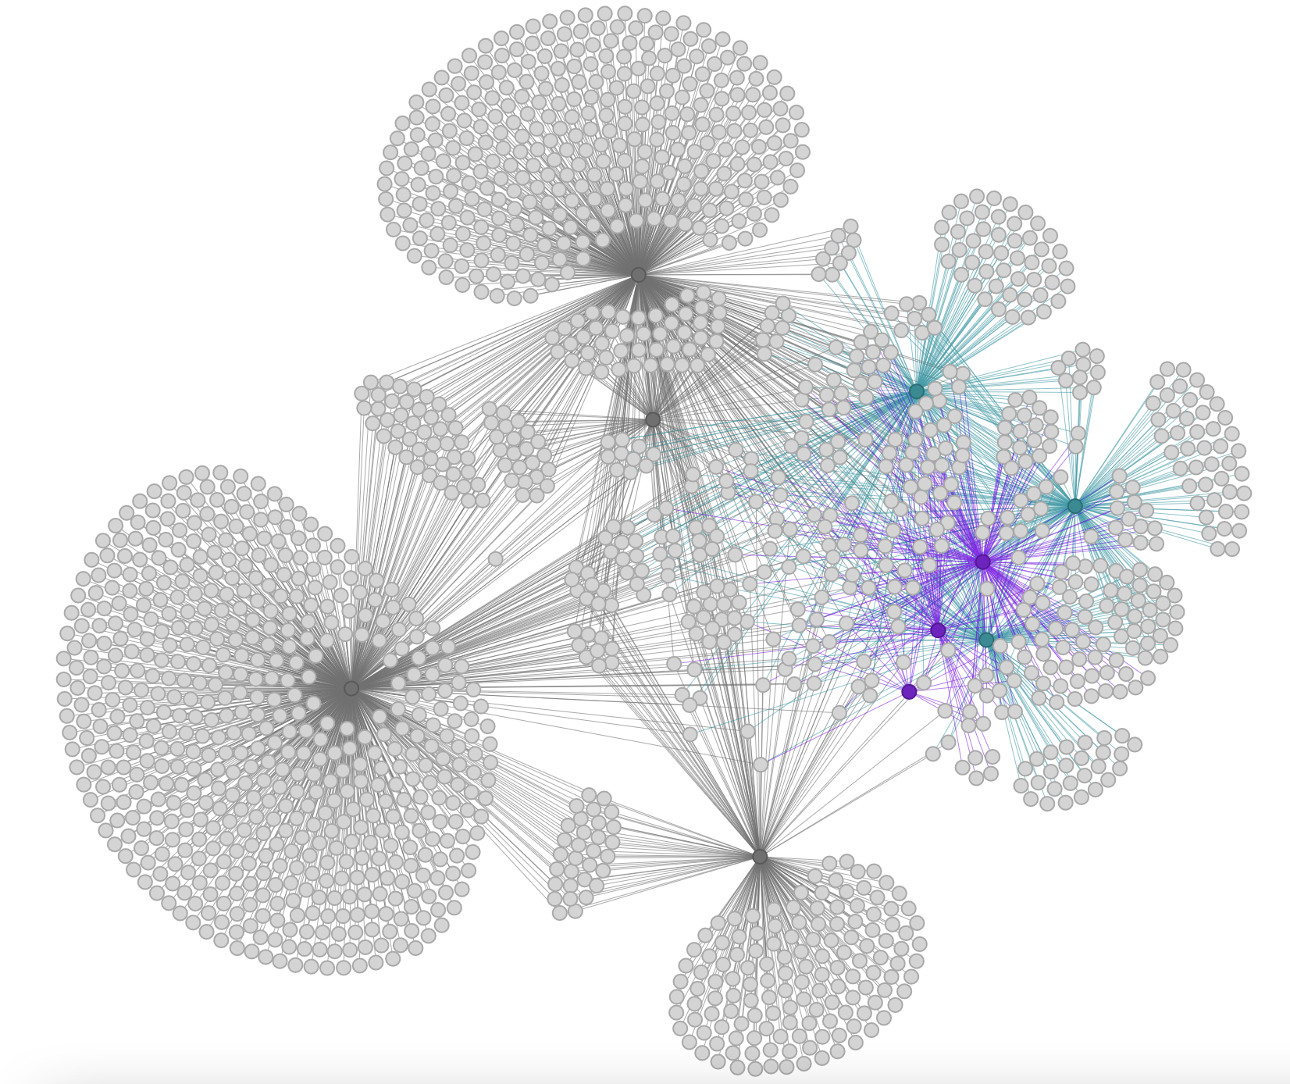
People
2018-2019
HTSAS
BC Apps
(50.9%)
(22.0%)
Sprint Apps
Coaching
(0%)
(21.6%)
SLP Apps
BC
Participants
(74.0%)
Sprint
Participants
SS
SLP
Participants
FF
(54.7%)
Notes:
Not going too deep into the percentages for the subfunnel, they’re comparable to what’s in the Teams data that I’ve already shown. I want to get deeper into the top of funnel

Slide 14
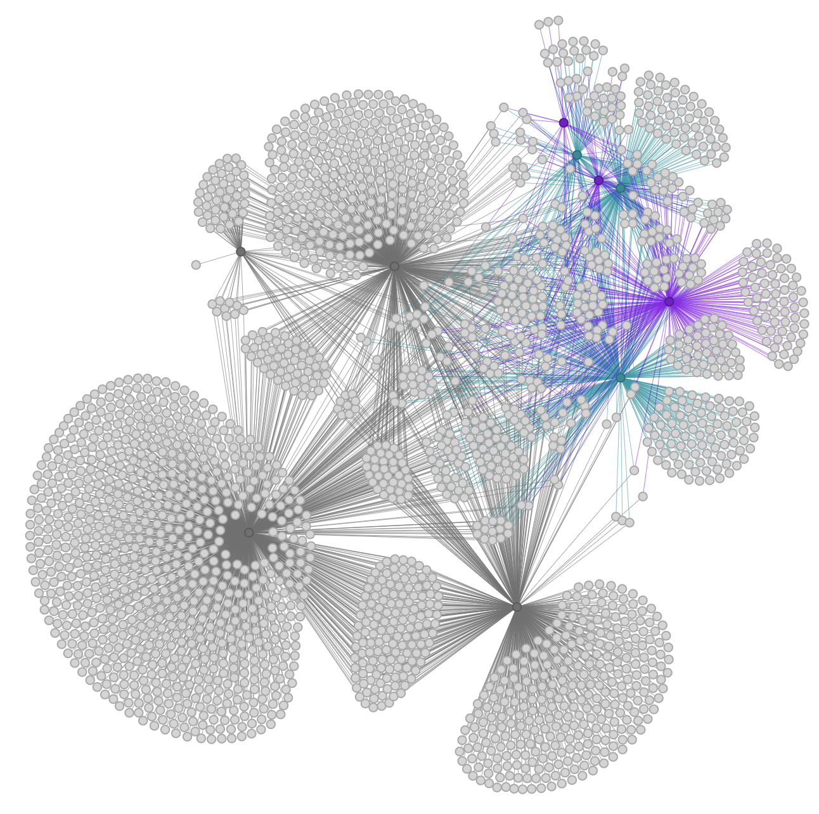
People 2019-2020
SLP
Participants
SLP Apps
Sprint
Participants
HTSAS
(43.0%)
Sprint Apps
Coaching
(22.7%)
(67.2%)
BC
Participants
SS
(48.9%)
FF
BC Apps

Slide 15
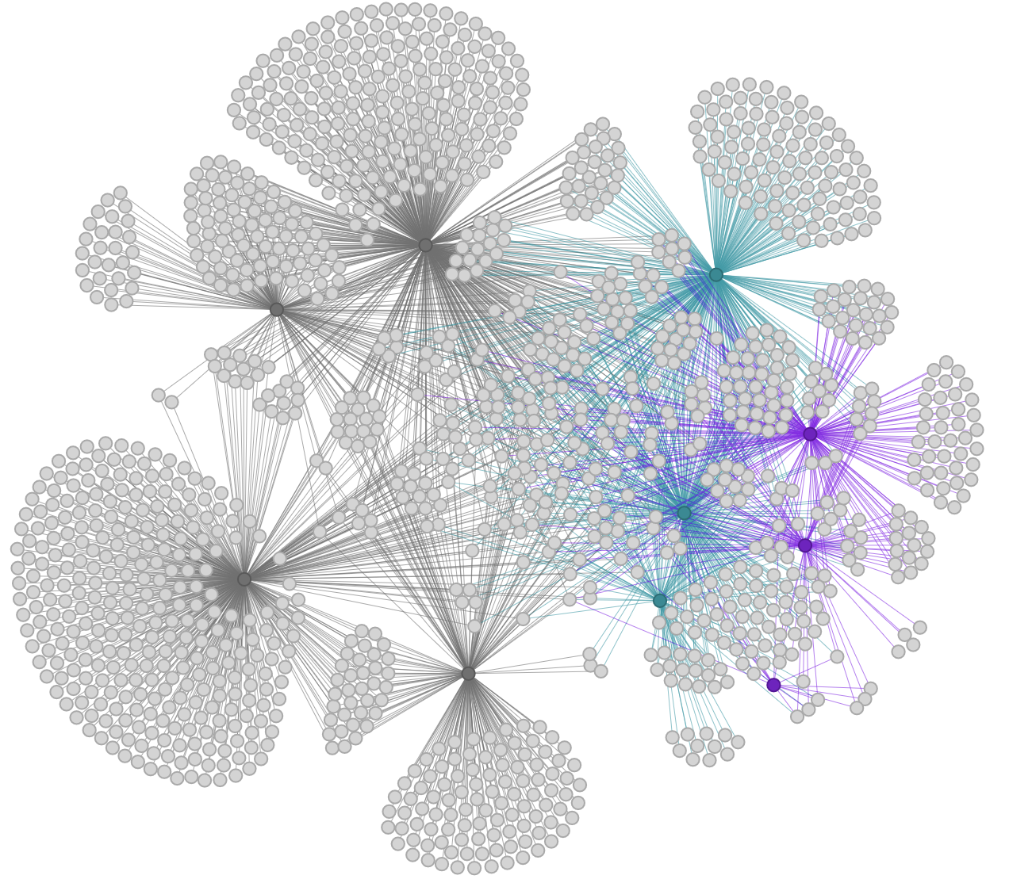
BC Apps
People
2020-2021
Sprint Apps
(35.9%)
HTSAS
(17.1%)
(13.6%)
Coaching
BC
Participants
(66.9%)
Sprint
Participants
SS
SLP
Participants
FF
(44.7%)
SLP Apps

Slide 16
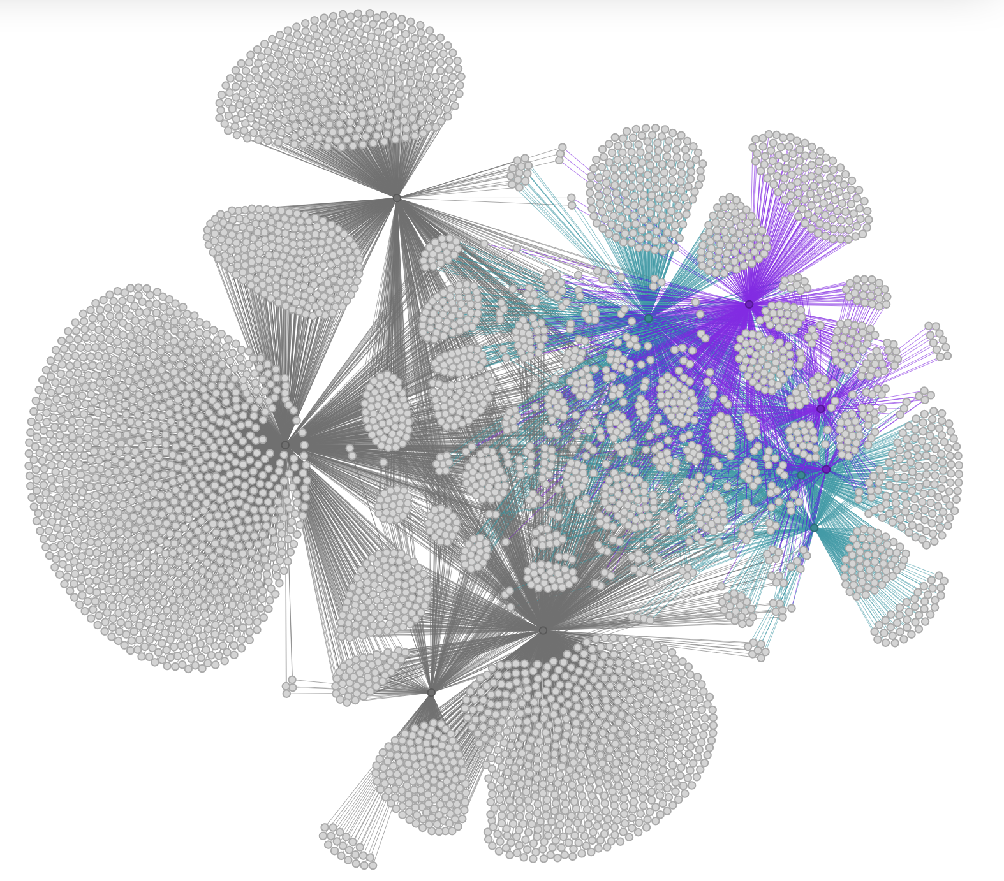
BC Apps
BC
Participants
Sprint Apps
People Fall
2018 –
Spring
2021
(38.0%)
FF
Sprint
Participants
(17.7%)
(54.9%)
SS
Coaching
SLP
Participants
(36.5%)
SLP Apps
HTSAS
(5.2%)

Slide 17
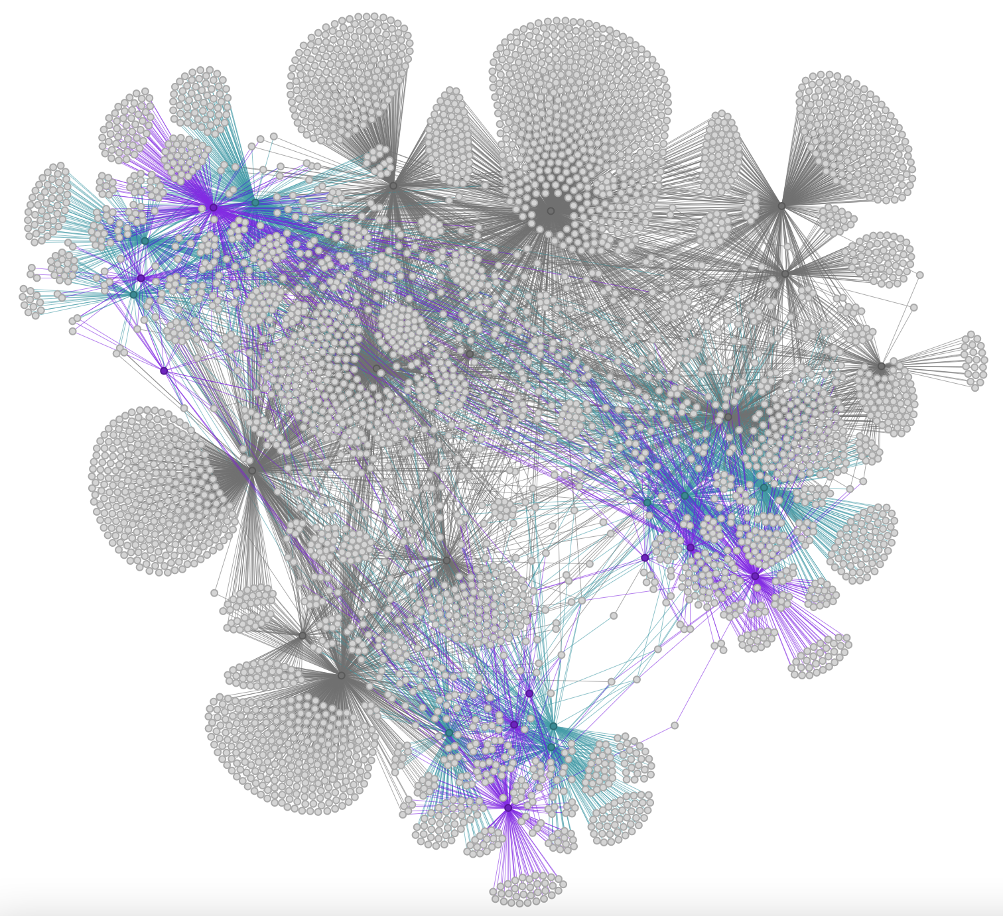
2019-2020
(19.3%)
500 people
2020-2021
(26.5%)
479 people
Across All 3 Years
2018-2019
Notes:
Shows relationship between the years
Calculated the rate of change - number of people who continued to participate next year over the total number of people in that year. Example: if 10 people participated from 2018-2019, and only 1 of them continued to participate into 2019-2020, that would be a follow-through rate of 5%

Slide 18
Analysis
Notes:
Some analysis

Slide 19
Most Interesting Findings
HTSAS is achieving the most follow through into other programs!
Could be because HTSAS is/isn’t considered coaching
SS and FF engaged more with each year – whatever we’re doing is working (keep pushing programs!)
Sub-funnel seems to behave the way hypothesized – by level of intensity

Slide 20
Data Cleanup Recs
Dropdown menus are your best friend! Include an “other” category and an extra field for more detailed info.
No commas and quotation marks (overloaded for computer)
Take this data in a consistent format:
Pronouns (include as many options as realistic)
Stick with ONE format (she/her vs. she/her/hers)
Ethnicity (checkboxes with “other”)
Academics (single choice)
Steal from a ”pick list” - use the same language on applications
Notes:
Cute anecdote for avoiding self description – someone listed themselves as “left-handed” on one of the applications for the summer programs, it’s things like that to avoid. Not only can I not analyze written text, people are just inclined to include wrong or irrelevant information.
SCHOOLS – stern, tandon, cas, etc
APPLICATIONS AND PARTICIPANTS, then gender
Data cubes

Slide 21
Final thoughts?
Notes:
If necessary

Slide 22
Appendix
Notes:
If necessary

Slide 23
Follow-through rate
For people and teams across all years, the follow-through rate was calculated by:
# people between the two years
------------
(# people earlier year)

Slide 24
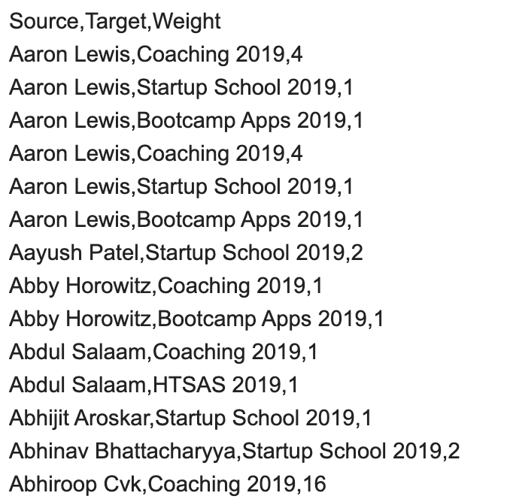
What is Adjacency?
Header
Relationships
Notes:
Adjacency lists have a minimum of 2 components, a source and a target. Between these two, an edge is made. Weights can also be included to measure the number of times an edge occurs. Duplicates are not a problem for this model because I ended up not using weights.

Slide 25




Color Key
- People/Teams
- Top Funnel
- Applicants
- Participants

